Slide 1

Design and Implementation of a 4-Bit RISC CPU Datapath
VERILOG HDL · 4-BIT RISC · 3-STAGE PIPELINE
Name: Than Nguyen Minh Nguyen
Roll no: SE204340

Slide 2
Project Aim and Scope
PROJECT AIM
To design, implement, and verify a functional 4-bit RISC CPU using Verilog HDL.
PROJECT SCOPE
Datapath Design
Control Design
Pipeline Architecture
Functional Verification
ALU, register file, and memory units.
Instruction decoder and hardwired control.
Three stages — IF, ID, and EX.
Simulation and testbench-based testing.
Expected Outcome: A working CPU capable of executing arithmetic, logic, memory, and jump instructions.
4-Bit RISC CPU Datapath · 02 / 10

Slide 3
System Specifications
Parameter | Specification
CPU architecture | 4-bit RISC-style
Instruction width | 12 bits
General-purpose registers | 4 registers: R0–R3
Instruction memory | 16 × 12 bits
Data memory | 16 × 4 bits
Program counter | 4 bits
Pipeline stages | IF, ID, EX
Control mechanism | Hardwired control
Implementation language | Verilog HDL
4-Bit RISC CPU Datapath · 03 / 10

Slide 4
Instruction Set Architecture
INSTRUCTION FORMAT · 12 BITS
[11:8]
[7:6]
[5:4]
[3:0]
Opcode
Rd
Rs
Immediate / Address
Selects the operation
Destination and first source
source register
Constant or address
SUPPORTED INSTRUCTIONS
Arithmetic
Logic
Data transfer
Memory access
Control flow
ADD · SUB
AND · OR · XOR · NOT
LDI · MOV
LOAD · STORE
JMP · JZ
Total: 12 implemented instructions, with 4 reserved opcodes.
4-Bit RISC CPU Datapath · 04 / 10

Slide 5
Overall CPU Datapath
MAIN FUNCTIONAL BLOCKS
MAIN DATA FLOW
Program Counter (PC)
Instruction Memory
IF/ID and ID/EX Pipeline Registers
Instruction Decoder
Register File
Operand Multiplexer
Arithmetic Logic Unit (ALU)
Flag Register
Data Memory
Write-Back Multiplexer
Branch Unit
Instruction Memory
↓
Decoder
↓
Register File / ALU
↓
Write-Back
MEMORY ORGANIZATION
Separate instruction and data memories (Harvard model).
4-Bit RISC CPU Datapath · 05 / 10

Slide 6
Three-Stage Instruction Pipeline
IF
ID
EX
Instruction Fetch
Instruction Decode
Execute
Read the instruction using the PC.
Prepare the instruction for decoding.
Identify the opcode and instruction fields.
Generate control signals.
Read operands and execute the operation.
Access data memory when necessary.
Write results and update applicable flags.
KEY BENEFIT
PERFORMANCE
Multiple instructions occupy different stages simultaneously.
One completed instruction per clock after pipeline fill.
4-Bit RISC CPU Datapath · 06 / 10

Slide 7
Pipeline Registers and Hazards
PIPELINE REGISTERS
HAZARD MANAGEMENT
Hazard | Design approach
Structural | Separate instruction and data memories
Data | Read operands during EX after preceding write-back
Control | Flush two younger instructions after a taken jump
IF/ID
Stores the fetched instruction, its address, and a valid bit.
ID/EX
Stores decoded control signals, register fields, immediate data, address, and a valid bit.
2
Jump penalty: 2 clock cycles. A flushed pipeline slot behaves as a NOP.
4-Bit RISC CPU Datapath · 07 / 10

Slide 8
Hardwired Control and Branching
ID STAGE
EX STAGE
BRANCH CONTROL
Instruction decoder
Branch unit
Control signals
Decodes the opcode.
Generates ALU, register, memory, and flag control signals.
Uses safe default values for reserved opcodes.
JMP addr
pc_sel = 1
always changes the PC.
select the jump target.
JZ addr
flush = 1
jumps only when Zero = 1.
clear the two younger pipeline instructions.
Reserved opcodes: Behave as NOPs.
4-Bit RISC CPU Datapath · 09 / 10

Slide 9
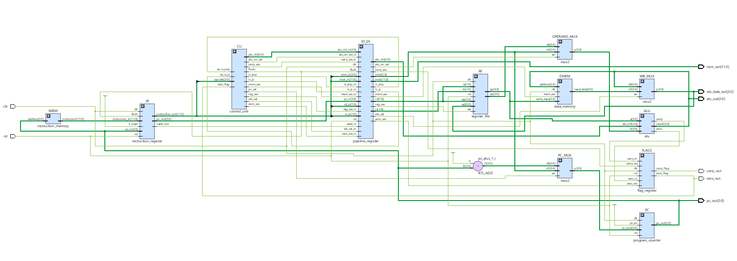

Slide 10
Verification Strategy
88
VERIFICATION COVERAGE
total checks across four testbenches
Arithmetic and logic results.
Register reads, writes, and reset.
Instruction decoding and control signals.
Sequential program execution.
JMP and conditional JZ behavior.
Pipeline flushing and valid reset state.
Checks for unknown x values on key outputs.
Testbench | Checks
ALU | 11
Register file | 11
Control unit | 22
Complete CPU | 44
Total | 88
4-Bit RISC CPU Datapath · 10 / 10

